Slide 1

Vector Representation
and
Components of a Given Vector

Slide 2
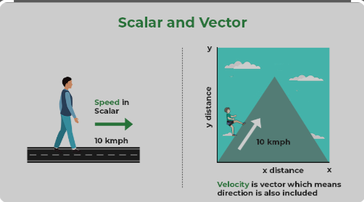

Slide 3
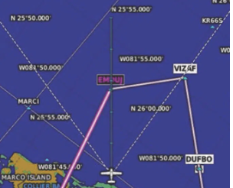

Slide 4
A vector can be thought of as an entity that has magnitude and direction, and is used to describe movement or change in space. Therefore, it is important to understand examples of vector problems in mathematics.
Vector quantities can be represented graphically with lines, so that:
The length of the line indicates the size, according to how the vector scale is expressed
The direction of the line represents the direction in which the vector quantity acts. The direction is indicated by the arrow.

Slide 5
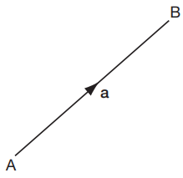
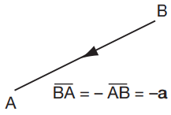
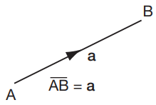
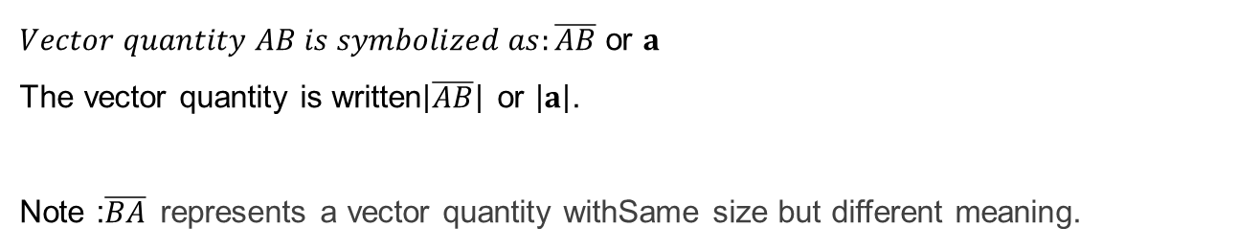
$Vector quantity AB is symbolized as:\overline{AB}$ or $a$
The vector quantity is written$\left|\overline{AB}\right|$ or $\left|a\right|$.
Note :$\overline{BA}$represents a vector quantity withSame size but different meaning.
$\overline{AB}=a$ $\overline{BA}=−\overline{AB}=−a$

Slide 6
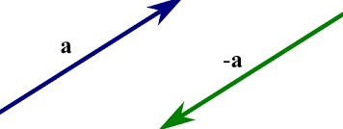
Two Same Vectors
If two vectors, 𝐚 and 𝐛, are said to be equal they have the same size and the same direction.
If 𝐚=𝐛, then
𝑎=𝑏 (the same size)
Direction 𝐚= direction 𝐛, namely two parallel vectors and in the same direction
If two vectors 𝐚 and 𝐛 have the value 𝐛=−𝐚, what about:
the size?
direction?

Slide 7
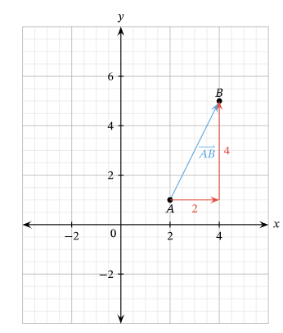
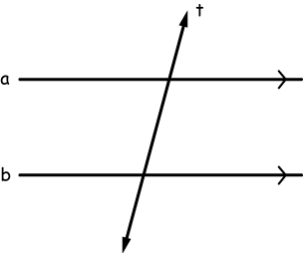
Vector Type
Position Vector represents the position of a point in space relative to specified coordinates.
Free vectors are not restricted in any way. It is determined by its magnitude and direction, it can be depicted as one of a set of parallel lines of equal length.

Slide 8
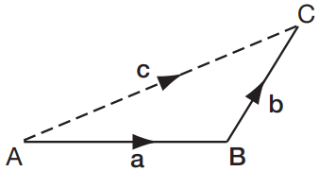
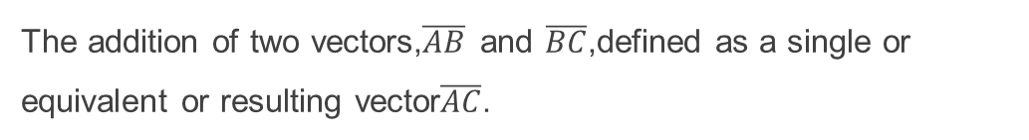
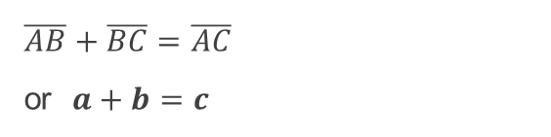
Vector Addition
The addition of two vectors,$\overline{AB}$ and $\overline{BC}$,defined as a single or equivalent or resulting vector$\overline{AC}$.
$\overline{AB}+\overline{BC}=\overline{AC}$
or $a+b=c$

Slide 9

Vector Components
Coordinates of points A(2,3), B (-1,4), C(0,-4) and D (-3,7)
Define the column vector components:
Answer 1. $\overline{AB}$ = $b$ - $a$ = ($\begin{matrix}−1 \\ 4\end{matrix}$) - ($\begin{matrix}2 \\ 3\end{matrix}$) = ($\begin{matrix}−3 \\ 1\end{matrix}$)
2. $\overline{BC }$ = ??
3. $\overline{DA }$ = ??

Slide 10

The size (length) of a vector on a plane
If Vector components$\overline{a}$ = ($\begin{matrix}a_{1} \\ a_{2}\end{matrix}$) , then Length
$\overline{a}$ =$\left|ā\right|$ = $\sqrt{a_{1}^{2 }{+ a}_{2}^{2}}$
Coordinates of points A(2,7), B (-1,3) and C (0,-4). Determine the length of vector AB
$\overline{AB}$ = $b$ - $a$ = ($\begin{matrix}−1 \\ 3\end{matrix}$) - ($\begin{matrix}2 \\ 7\end{matrix}$) = ($\begin{matrix}−3 \\ −4\end{matrix}$)
$\left|AB\right|$ = $\sqrt{{−3}_{}^{2 }{+ (−4}_{}^{2}}$) = $\sqrt{9+16 }$ =$\sqrt{25}$ = 5 (Length of vector AB)

Slide 11
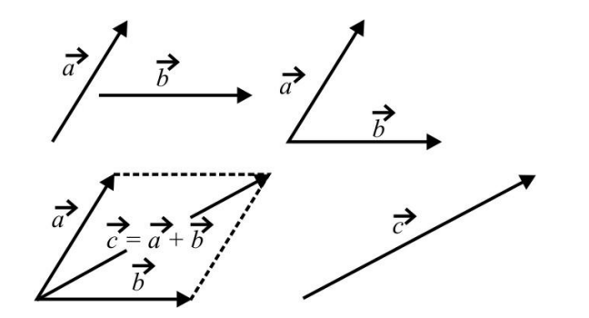
parallelogram

Slide 12
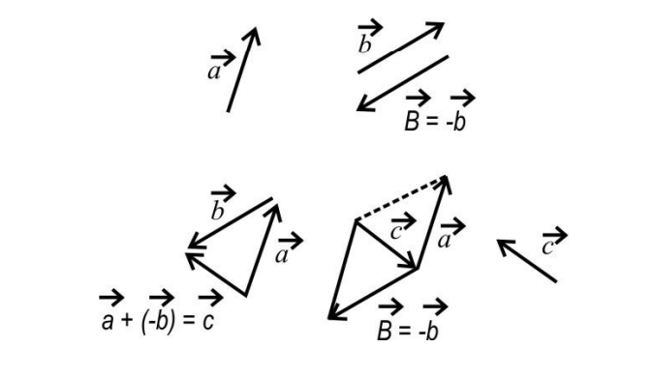
triangle

Slide 13
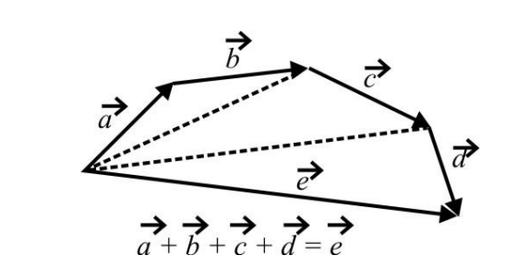
polygon

Slide 14
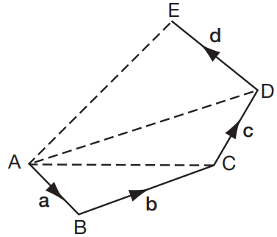






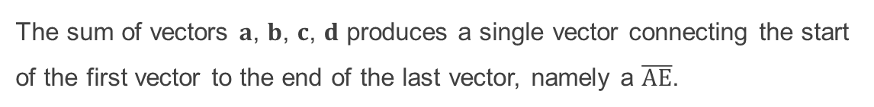
Vector Sum $a+b+c+d+ . . .$
Example 1
$a+b=\overline{AC}$
$$\overline{AC}+c=\overline{AD}$$
$a+b+c=\overline{AD}$
$$\overline{AD}+d=\overline{AE}$$
$a+b+c+d=\overline{AE}$
The sum of vectors 𝐚, 𝐛, 𝐜, 𝐝 produces a single vector connecting the start of the first vector to the end of the last vector, namely a $\overline{AE}$.

Slide 15
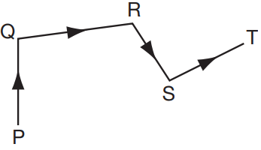


Vektor Sum $a+b+c+d+ . . .$
What about the results of vector addition?
$$\overline{PQ}+\overline{QR}+\overline{RS}+\overline{ST}= . . . . . . . . . .$$

Slide 16
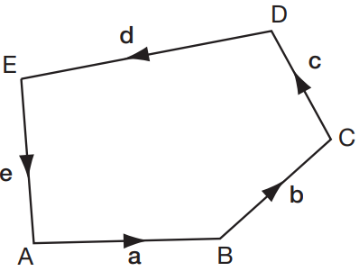
Vector Sum $a+b+c+d+ . . .$
Example 2
What is the result of adding vectors 𝐚, 𝐛, 𝐜, 𝐝, 𝐞 in the vector image beside?
Vector sum = $0$
Example 3
$$\overline{AB}+\overline{BC}−\overline{DC}−\overline{AD}=\overline{AB}+\overline{BC}+\overline{CD}+\overline{DA}=0$$

Slide 17
Vector Sum 𝐚+𝐛+𝐜+𝐝+ . . .
If the vector diagram is an unclosed image, the end of the last vector is not connected to the first vector, then the resulting vector sum of a single vector is equivalent to connecting the start of the first vector with the end of the last vector.
If the vector diagram is a closed figure, the end of the last vector is connected to the first vector, then the resulting sum is a vector without magnitude.

Slide 18
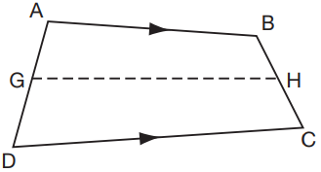
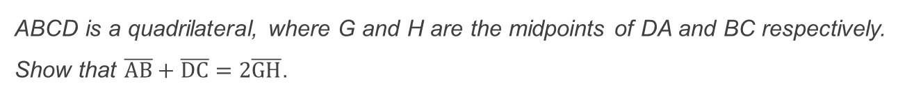
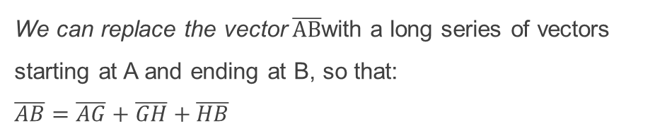
Components of a Given Vector
ABCD is a quadrilateral, where G and H are the midpoints of DA and BC respectively. Show that $\overline{AB}+\overline{DC}=2\overline{GH}$.
We can replace the vector$\overline{AB}$with a long series of vectors starting at A and ending at B, so that:
$\overline{AB}=\overline{AG}+\overline{GH}+\overline{HB}$
What about the vector$\overline{DC}= . . . ?$

Slide 19
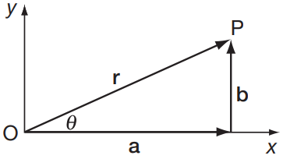
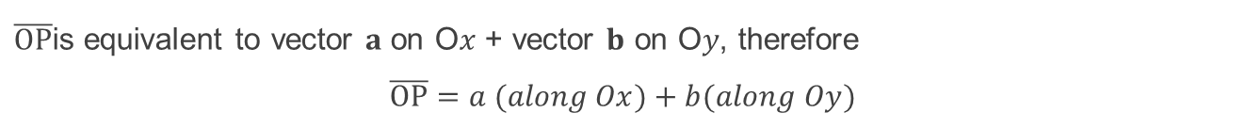
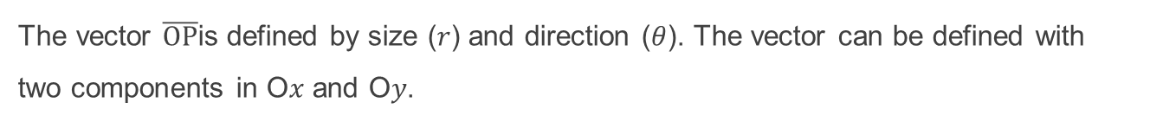
Components of a Vector in Terms of Unit Vectors
The vector $\overline{OP}$is defined by size (𝑟) and direction (𝜃). The vector can be defined with two components in O𝑥 and O𝑦.
$\overline{OP}$is equivalent to vector 𝐚 on O𝑥 + vector 𝐛 on O𝑦, therefore
$$\overline{OP}=a (along Ox)+b(along Oy)$$

Slide 20
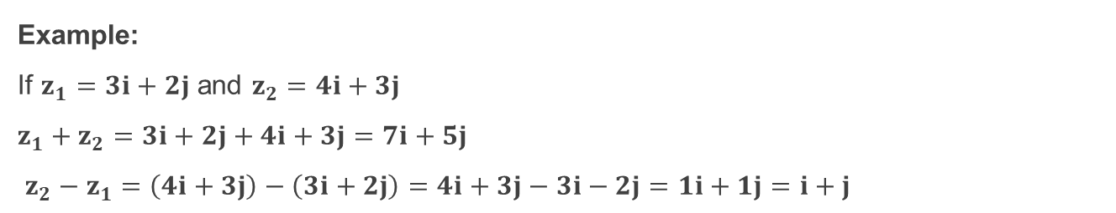
Components of a Vector in Terms of Unit Vectors
If we define 𝐢 as a unit vector in the O𝑥 direction, then 𝐚=𝒂𝐢
If we define 𝐣 as a unit vector in the Oy direction, then 𝐛=𝒃𝐣
So the OP vector can be written as:
𝐫=𝒂𝐢+𝒃𝐣
where 𝐢 and 𝐣 are unit vectors in the O𝑥 and Oy directions.
Example:
If $z_{1}=3i+2j$ and $z_{2}=4i+3j$
$z_{1}+z_{2}=3i+2j+4i+3j=7i+5j$
$z_{2}−z_{1}=\left(4i+3j\right)−\left(3i+2j\right)=4i+3j−3i−2j=1i+1j=i+j$

Slide 21
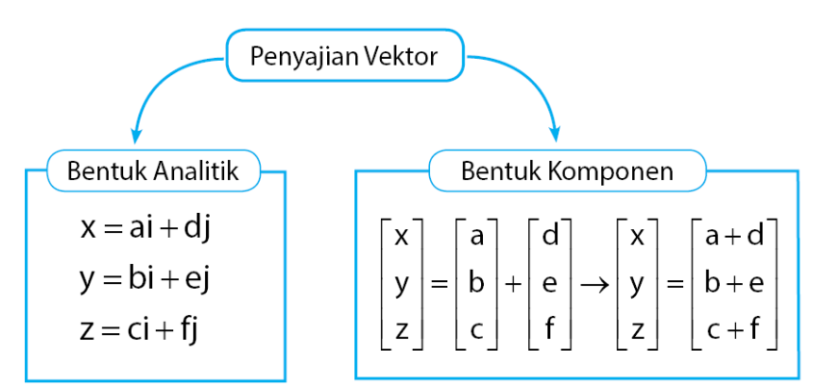

Slide 22
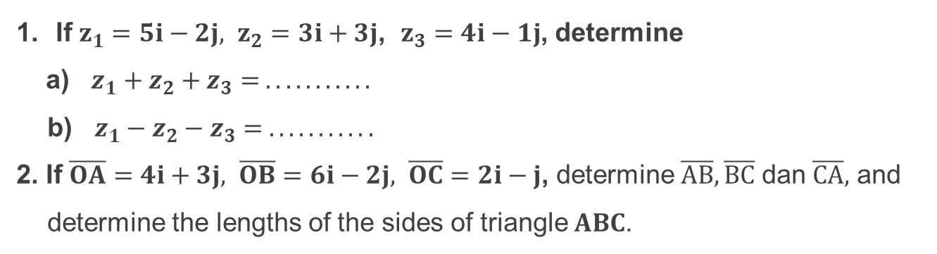
Latihan Soal
If $z_{1}=5i−2j, z_{2}=3i+3j$, $z_{3}=4i−1j$, determine
a) $z_{1}+z_{2}+z_{3}= . . . . . . . . . . .$
b) $z_{1}−z_{2}−z_{3}= . . . . . . . . . . .$
2. If $\overline{OA}=4i+3j, \overline{OB}=6i−2j, \overline{OC}=2i−j$, determine $\overline{AB}, \overline{BC}$ dan $\overline{CA},$ and determine the lengths of the sides of triangle 𝐀𝐁𝐂.

Slide 23
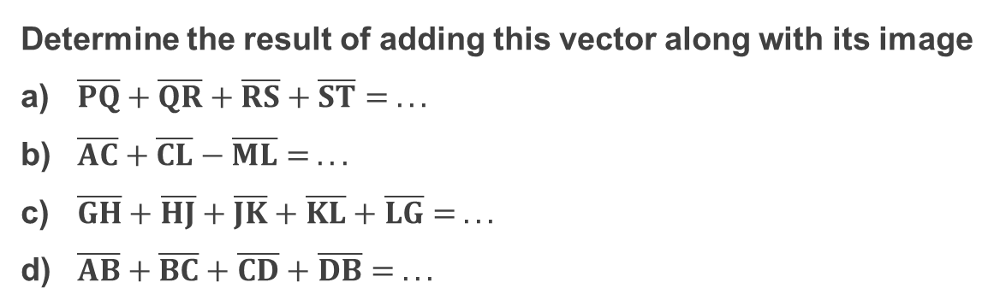
3. Vector Sum
Determine the result of adding this vector along with its image
$\overline{PQ}+\overline{QR}+\overline{RS}+\overline{ST}= . . .$
$\overline{AC}+\overline{CL}−\overline{ML}= . . .$
$\overline{GH}+\overline{HJ}+\overline{JK}+\overline{KL}+\overline{LG}= . . .$
$\overline{AB}+\overline{BC}+\overline{CD}+\overline{DB}= . . .$

Slide 24
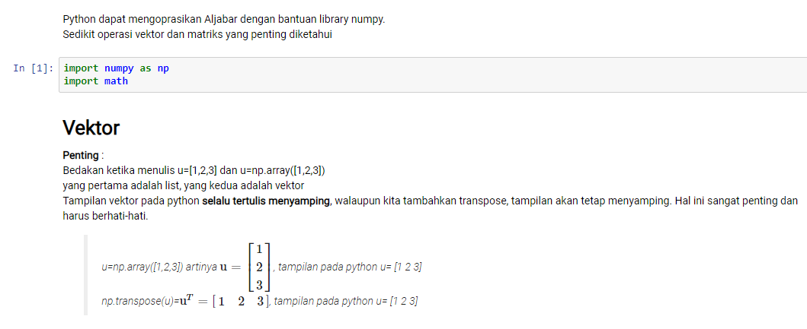

Slide 25
reference
http://repository.ut.ac.id/4526/1/PEFI4425-M1.pdf

